Slide 1


My Movie List
Organize and track your movie-watching experience with our comprehensive "My Movie List" project.

Slide 2
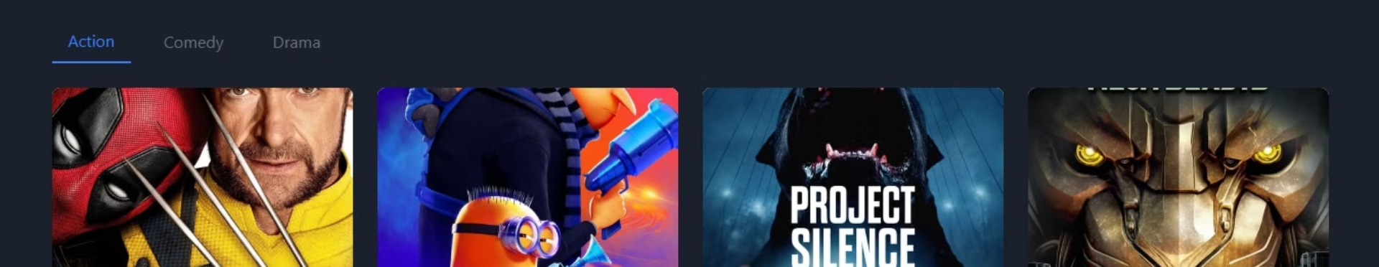
Introduction
Discover the purpose and benefits of our "My Movie List" project to enhance your cinematic journey.

Slide 3

Key Objectives
1
Movie Tracking
2
Watchlist
Easily keep track of the movies you've watched.
Maintain a personalized list of movies to watch in the future.
3
Sharing
Share your movie preferences and recommendations with friends.

Slide 4
Main Features
Watchlist
Movie Details
Dark Mode
Search Functionality
Seamlessly add and manage movies you want to watch.
Explore in-depth information about each movie.
Enjoy a visually-stunning dark theme for enhanced viewing.
Fetch relevant movie data from the TMDb API and display results in real-time

Slide 5
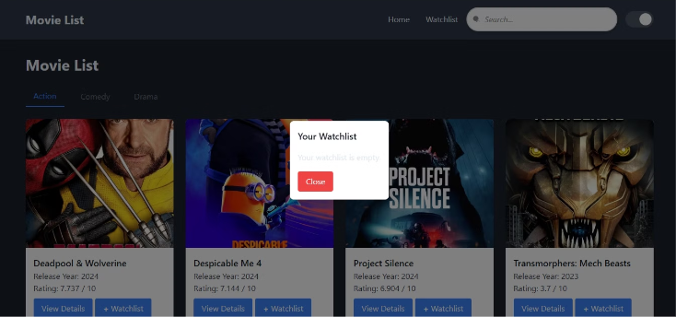
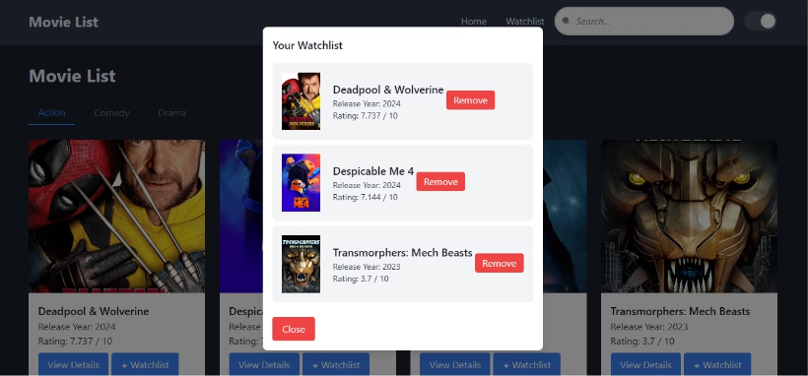
Watchlist
The watchlist feature in My Movie List enables users to save movies they plan to watch later. Users can add movies to their personalized watchlist, which is stored in the browser's local storage, allowing them to easily access and manage their selected movies at any time.
Empty List
List With Movies Added

Slide 6
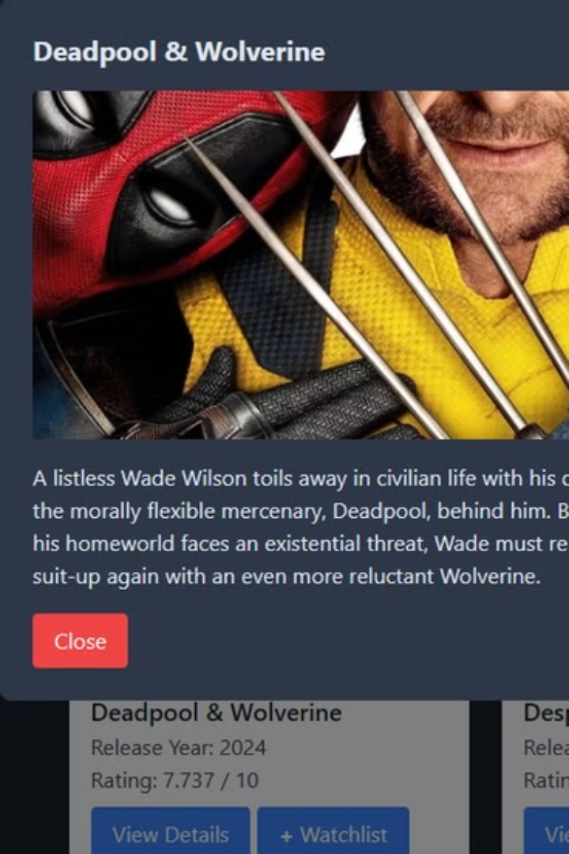
Movie Details
The movie details feature in My Movie List provides users with comprehensive information about each movie. When a movie is selected, it displays details such as the release date, rating, description, and poster, fetched directly from the TMDb API, giving users a clear and detailed overview of the movie.

Slide 7
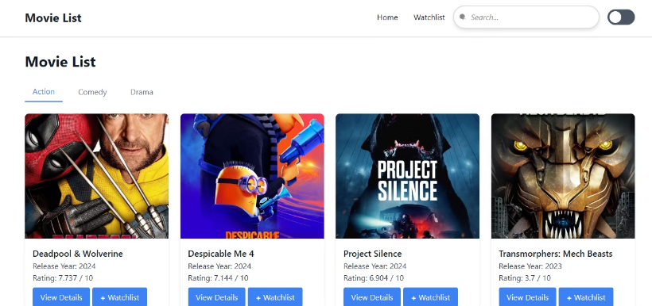
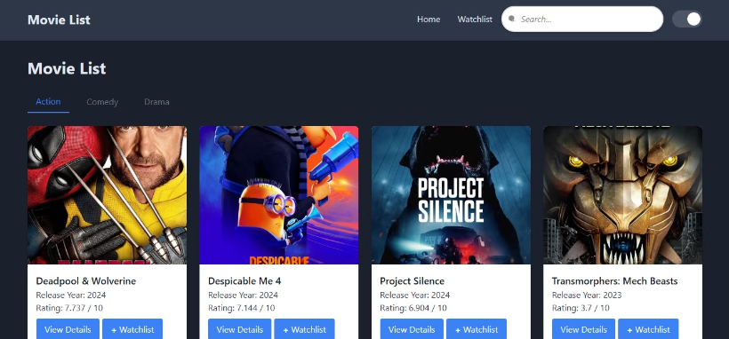
Dark Mode
The dark mode feature in My Movie List enhances user experience by allowing them to switch between light and dark themes. This functionality adjusts the interface's colors to reduce eye strain in low-light environments, and the user's preference is saved for future visits, ensuring a personalized and comfortable browsing experience.
Before
After

Slide 8
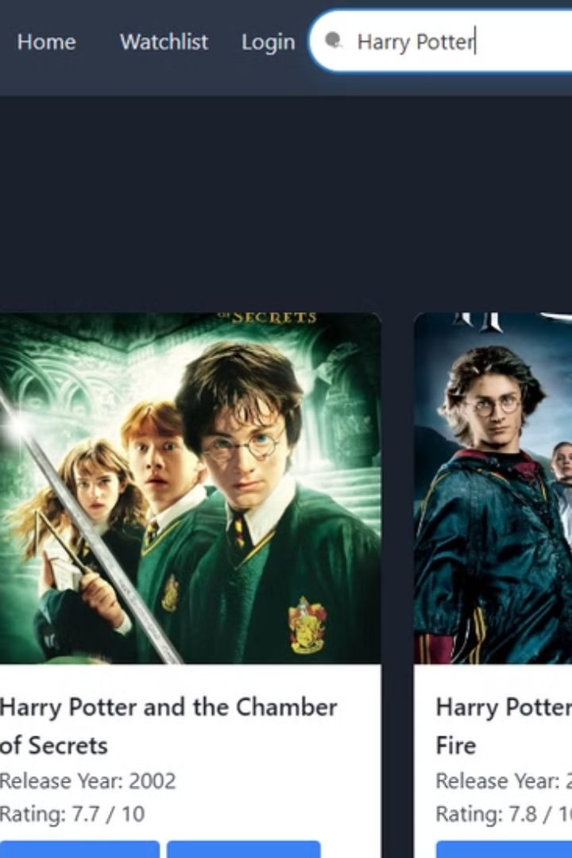
Search Functionality
The search functionality in My Movie List allows users to quickly find movies by typing keywords in the search bar. It fetches relevant movie data from the TMDb API and displays results in real-time, helping users easily discover and add movies to their watchlist or view detailed information.

Slide 9




Tools and Technologies
Firebase
TMDb API
Secure and scalable backend for data storage and management.
Comprehensive movie database for detailed information.
Tailwind CSS
JavaScript
Utility-first CSS framework for rapid UI development.
Powerful programming language for interactive user experiences.

Slide 10
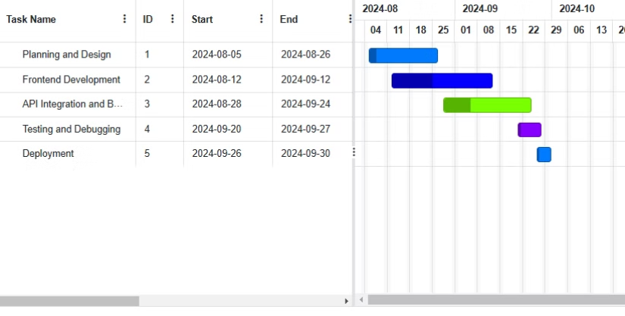
Project Roadmap
1
Planning
Define project scope, features, and technical requirements.
2
Development
Implement core functionality and integrate with APIs.
3
Testing
Ensure seamless user experience and address any issues.
4
Deployment
Launch the application and make it available to users.

Slide 11

Future Enhancements
User Authentication
Movie Trailers
Adding Firebase Authentication for secure login and watchlist syncing across devices.
Integrate APIs to display trailers alongside movie details.
Personalized Recommendations
Social Sharing
Allow users to share their movie lists and reviews with friends.
Suggest movies based on user preferences and viewing history.
Mobile App Integration
Advanced Analytics
Develop a seamless mobile experience for on-the-go movie management.
Provide detailed insights into user movie-watching patterns and trends.

Slide 12





Conclusion
Streamlined
Effortlessly manage your movie-watching journey.
Insightful
Gain valuable insights into your cinematic preferences.
Shareable
Connect with friends and discover new movie recommendations.

Slide 13

Q&A
Questions?
We're here to help!
Feedback?
Your input matters to us.

